Slide 1
Fifth Grade
Wilkinson Gardens Elementary
Mrs. Bailey
(Principal)
Mrs. Elrod
(Assistant Principal)
2025-2026

Slide 2
Welcome!
Welcome to fifth grade!
Students will have three teachers and four core subjects …
Math, Language Arts, Science, and Social Studies!
The fifth grade teachers are
Ms. Larke (Language Arts),
Ms. Jefferson (Mathematics), and
Mr. Bush (Science/Social Studies).

Slide 3
Rules & Expectations
R.O.A.R.
I AM….
RESPECTFUL TO OTHERS…
ORDERLY AT ALL TIMES…
ALWAYS PUTTING SAFETY FIRST…
READY FOR SUCCESS…
Notes:
Ask students the following questions. Consider recording answers on chart paper and posting in the classroom: What does respect mean? If you respect something or someone, what are some thing you do? What are some things you don’t do? What does it mean to be responsible? Safe? Kind?

Slide 4
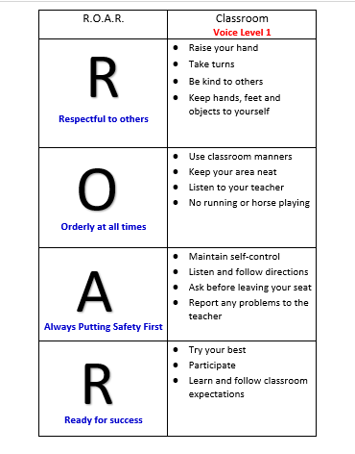
WGES Expectation Matrix
This chart shows school’s expectations.

Slide 5
Homework
Homework is given Monday-Thursday, when applicable.
Homework may focus on math, language arts, science, and/or social studies.
Students are expected to complete and turn in homework assignments according to the particular deadlines provided by your teachers.
Homework communications can be found in school agenda, homework folder, and/or on ClassDojo.

Slide 6
School Times
Breakfast is from 7:50 am-8:20 am in the homeroom classroom.
School hours are from 8:20 am-3:10 pm.
Students are considered tardy at 8:25 am.
Dismissal-Transportation
  Students Exit
    Walkers-2nd Grade Hall
    Car Riders –Gym
    Van Riders-Front Door
    Bus Riders-Cafeteria

Slide 7
Transportation
If there is a change at any time in transportation, different from what is provided at registration to the school, please provide a written note permitting this change. Otherwise transportation can NOT be altered.
  Include
    Date Note is Written
    Date(s) of Change (Temporary or Permanent)
    Parent/Guardian's Name
    Student's Name
    The Updated Transportation

Slide 8
Transportation
To contact or access Richmond County's Transportation Department in relation to bus routes...
RCBOE Transportation Contact
(706) 796-4777
https://www.rcboe.org/domain/95

Slide 9
Attendance
School Attendance is tied to Academic Achievement. Every Day Counts.
If your child is absent, please send a written guardian's excuse or doctor's excuse the following day stating the reason for the absence.
  Include
    Date Note is Written
    Date(s) of Absence(s)
    Parent/Guardian's Name
    Student's Name
    Guardian's Written Excuse or Doctor's Excuse

Slide 10

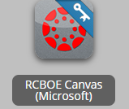
School Technology
What is Launchpad?
https://launchpad.classlink.com/rcboe
What is Canvas?
https://www.rcboe.org/Domain/16265

Slide 11
Communication
We may use various means to communicate with you…
  phone calls, email
  ClassDojo text
  school agenda
  homework folder
  graded papers
  grade reports
  letter-flyers
  Infinite Campus Parent Portal
  Canvas
  conferences

Slide 12
Our Responsibilities to Our Students
To TEACH
To ENCOURAGE
To HELP students meet/exceed their goals
To PREPARE students for their future careers and other endeavors
We are here for you!!!- Use your resources!

Slide 13
Communication
Teacher Contacts
Phone: 706 737 7219
Jefferson:
JeffeTe@boe.richmond.k12.ga.us
Larke:
LarkeAl@boe.richmond.k12.ga.us
Bush:
BushDe@boe.richmond.k12.ga.us

Slide 14
Three Things WE Need You to Do:
Sign up for grades communication with INFINITE CAMPUS
Sign up for ClassDojo updates...behavior, general information, etc.
Update us with any new changes...number, address or special information pertaining to your child

